Slide 1
C++ Functions
Nilanjana G. Basu, HIT, Kolkata

Slide 2
Introduction
A function is a set of program statements that can be processed independently.
The communication between a caller(calling function) and a callee(called function) takes place through parameters
Advantages:
Modular programming
Reduction in the amount of work and development time
Program and function debugging is easier
Reduction in size
Reuse of code
Library of function can be implemented

Slide 3
Program 1
#include<iostream>
using namespace std;
struct student{
string name;
string roll;
int age;
void display(){
cout<<endl << "Name: "<<name <<endl << "Roll: "<<roll <<endl <<"Age: "<< age << endl<< endl;
}
void input(){
cout<< "Enter Input" <<endl;
cout<< "Enter Name" <<endl;
getline(cin, name);
cout<< "Enter Roll" <<endl;
getline(cin, roll);
cout<< "Enter Age" <<endl;
cin>> age;
cin.ignore();
}
};

Slide 4
Program 1
int main(){
student s[5];
for(int i=0;i<5;i++)
{
s[i].input();
s[i].display();
}
return 0;
}

Slide 5
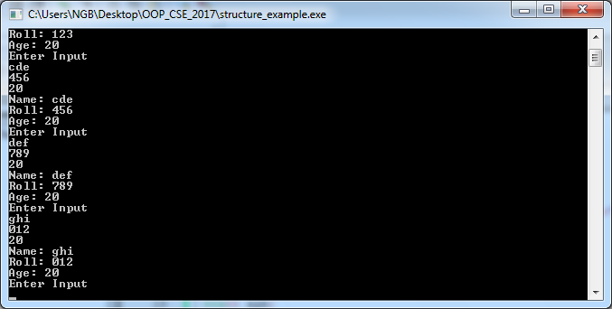
Output

Slide 6
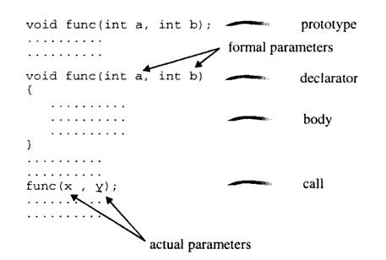
Function components

Slide 7
Program 2
#include<iostream>
using namespace std;
long fact(int);//prototype
int main(){//caller
cout<< "Enter Input"<<endl;
int f;
cin>>f;
cout<<"Factorial of "<<f<<" is "<<fact(f)<<endl; // function call
return 0;
}
long fact(int a){ //definition
if(a==0)
return 1;//return statement
else
return a*fact(a-1);//return statement
}

Slide 8
Points to remember
Function prototype can be eliminated by defining the function before calling it.
Otherwise it gives the compiler error:
“fact was not declared in this scope”

Slide 9
Parameter passing
Call by value
Call by address
Call by reference

Slide 10
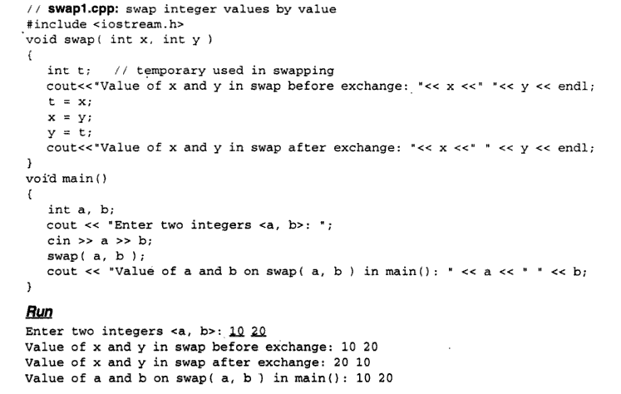
Call by Value

Slide 11
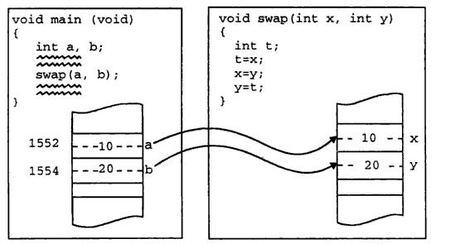
Call by value example

Slide 12
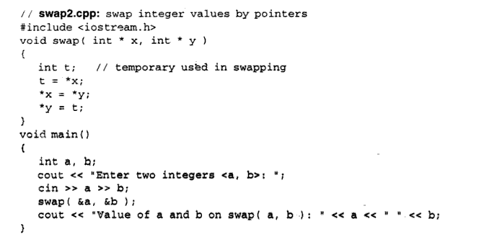
Call by address

Slide 13
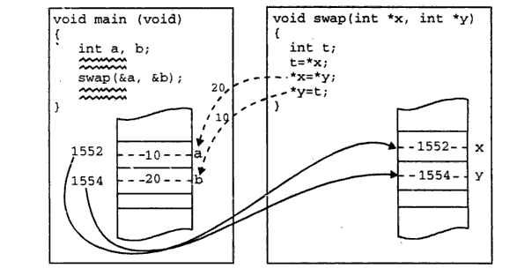
Call by address example

Slide 14
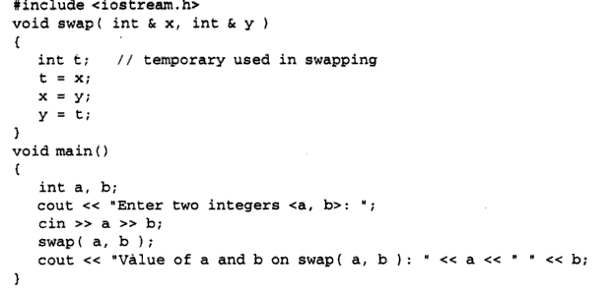

Call by reference

Slide 15
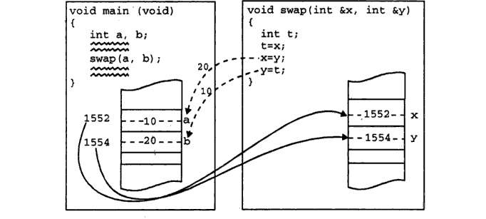
Call by reference example

Slide 16
Points to remember
A reference can never be null
Once established, a reference cannot be changed so as to make it point to a different variable
A reference does not require any explicit mechanism to dereference the memory address and access the actual data value
So to swap two variables, call by reference is preferable

Slide 17
Return by reference
#include<iostream>
using namespace std;
int & min(int &, int &);//prototype
int main(){//caller
cout<< "Enter Input"<<endl;
int f,g;
cin>>f>>g;
cout<<"Min is "<<min(f,g)<<endl; // function call
cout<<" f and g is "<<f<<" "<<g<<endl;
min(f,g)=100;
cout<<" f and g is "<<f<<" "<<g<<endl;
return 0;
}
int & min(int & a, int & b){ //definition
if(a<b)
return a;//return statement
else
return b;/*return statement */ }

Slide 18
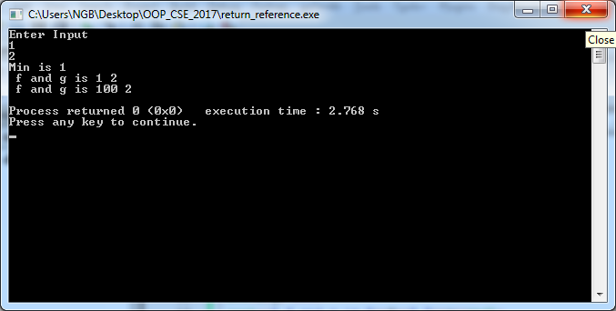
Output

Slide 19
Default Arguments
In a C++ function call, when one or more arguments are omitted, the function may be defined to take default values for the omitted arguments by providing default values in the function prototype or in the definition
Parameters without default value are placed first and those with default values are placed later (C++ stores the actual arguments on stack from right to left)
Otherwise it gives you compiler error “default argument missing for parameter…”

Slide 20
Program 7
#include<iostream>
using namespace std;
void add(int=100, int=100, int=200, int=200);
int main(){
add();
add(1);
add(1,2);
add(1,2,3);
add(1,2,3,4);
return 0;
}
void add(int a, int b, int c, int d){
cout<<"Addition is "<<a+b+c+d<<endl;}

Slide 21
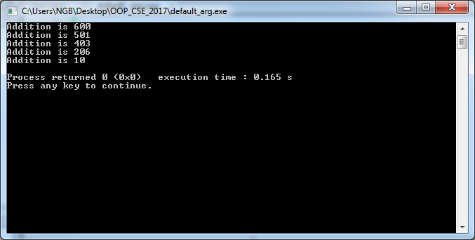
Output

Slide 22
How stack looks like
add(1,2)
void add(int a=100, int b=200, int c, int d)
void add(int a, int b, int c=100, int d=200)
a
1
2
b

Slide 23
Program 8
#include<iostream>
using namespace std;
void add(int,int=100, int=100, int=200, int=200);
int main(){
add(0);
add(0,1);
add(0,1,2);
add(0,1,2,3);
add(0,1,2,3,4);
return 0;
}
void add(int a, int b, int c, int d, int e){
cout<<"Addition is "<<a+b+c+d+e<<endl;}

Slide 24

Output

Slide 25
Inline function
If the time required to execute a function is relatively smaller than the context switch time, inline functions are the solution
Function body is inserted in place of the function call statement during the compilation process
Similar to macro in C but there are differences
Just write “inline” keyword before function name in the function definition. It is like a request to compiler to make this function inline but if the function will be treated as an inline function, that depends on the compiler.

Slide 26
Inline function vs Macros
Inline | Macro
Inline functions are parsed by the compiler. | Macros are expanded by the preprocessor.
Keyword inline is used | Keyword #define is used
It evaluates the argument only once. | It evaluates the argument each time it is used in the code.
The compiler may not inline and expand all the functions. | Macros are always expanded.
The short functions, defined inside the class are automatically made onto inline functions. | Macros should be defined specifically.
Debugging is easy for an inline function as error checking is done during compilation. | Debugging becomes difficult for macros because the preprocessor does the textual replacement which is not visible in the source code itself.
Type checking is done | No type checking
Inline function can be defined inside or outside the class. | Macros are always defined at the start of the program.

Slide 27
Function Overloading
#include<iostream>
using namespace std;
void add(int, int,int=100, int=100);
void add();
void add(int,int,int);
void add(int);
int main(){
add();
//add(0,1,2);
add(0,1,2,3);
add(1);
return 0;
}

Slide 28
Example Program
void add(int a, int b, int c, int d){
cout<<"Addition is "<<a+b+c+d<<endl;
}
void add(){cout<<"HI"<<endl;}
void add(int a, int b, int c){cout<<a+b+c<<endl;}
void add(int a){cout<<a<<endl;}

Slide 29
Points to remember
Overloaded functions have same name but different argument lists (i.e. number, type and sequence can vary)
Each overloaded function does same type of operation on different type of arguments. Implementation or body of the function should be different

Slide 30
Command line arguments
#include<iostream>
using namespace std;
int main(int argc, char **argv, char** envp){
int i=0;
for(;i<argc;i++)
cout<<argv[i]<<endl;
//while(*envp[i])
cout<<envp[i++]<<endl;
return 0;}

Slide 31
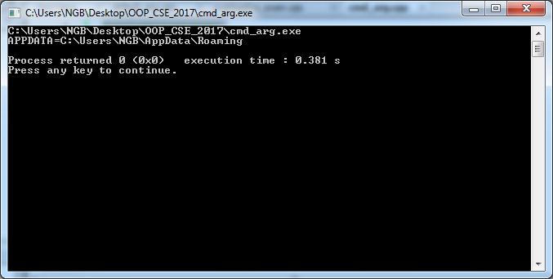
Output

Slide 32
Functions with variable number of arguments
A function which takes variable number of arguments, for example, it looks like:
int sum(int n,...), double average(int n,...)
The three ellipses mean that there are a variable number of arguments following. The place you will have used them (perhaps without realizing) are the printf family of functions.
They allow you to create functions of that style where the parameters are not known beforehand, and you can use the varargs functions (va_start, va_arg and va_end) to get at the specific arguments.

Slide 33
Steps to follow to use varag functions
Define a function with its last parameter as ellipses and the one just before the ellipses is usually an int which will represent the number of arguments.
Create a va_list type variable in the function definition. This type is defined in stdarg.h header file.
Use int parameter and va_start macro to initialize the va_list variable to an argument list. The macro va_start is defined in stdarg.h header file.
Use va_arg macro and va_list variable to access each item in argument list.
Use a macro va_end to clean up the memory assigned to va_list variable.
To use such functionality, you need to make use of cstdarg header file which provides the functions and macros to implement the functionality of variable arguments

Slide 34
Program 1
#include <iostream>
#include <cstdarg>
using namespace std;
double average(int num,...)
{ va_list valist; double sum = 0.0; int i;
va_start(valist, num); //initialize valist for num number of arguments
for (i = 0; i < num; i++) { //access all the arguments assigned to valist
sum += va_arg(valist, int); }
va_end(valist); //clean memory reserved for valist
return sum/num;
}
int main() {
cout << "Average of 2, 3, 4, 5 = "<< average(4, 2,3,4,5) << endl;
cout << "Average of 5, 10, 15 = "<< average(3, 5,10,15)<< endl;
return 0;
}

Slide 35
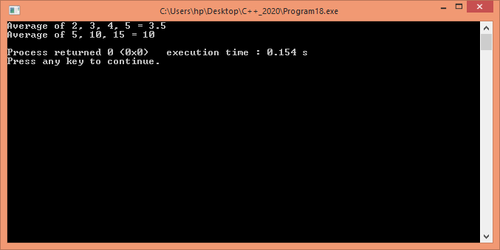
Output
https://stackoverflow.com/questions/1657883/variable-number-of-arguments-in-c

Slide 36
Program 2
/* va_arg example */
#include <iostream>
#include <cstdarg> /* va_list, va_start, va_arg, va_end */
using namespace std;
int FindMax (int n, ...)
{
int i,val,largest;
va_list vl;
va_start(vl,n);
largest=va_arg(vl,int);
for (i=1;i<n;i++)
{
val=va_arg(vl,int);
largest=(largest>val)?largest:val;
}
va_end(vl);
return largest; }

Slide 37
Program 2
int main ()
{
int m;
m= FindMax (7,702,422,631,834,892,104,772);
cout<<"The largest value is: "<<m<<endl;
return 0;
}

Slide 38
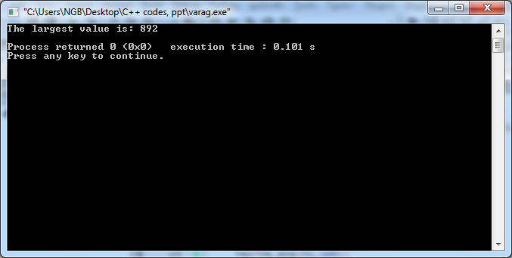
Output

Slide 39
Program 3
#include <iostream>
#include <cstdarg> /* va_list, va_start, va_arg, va_end */
using namespace std;
void PrintLines (char* first, ...)
{
char* str;
va_list vl;
str=first;
va_start(vl,first);
do {
cout<<str<<" ";
str=va_arg(vl,char*);
} while (str!=NULL);
va_end(vl);
}

Slide 40
Program 3
int main ()
{
PrintLines ("First","Second","Third","Fourth",NULL);
return 0;
}

Slide 41
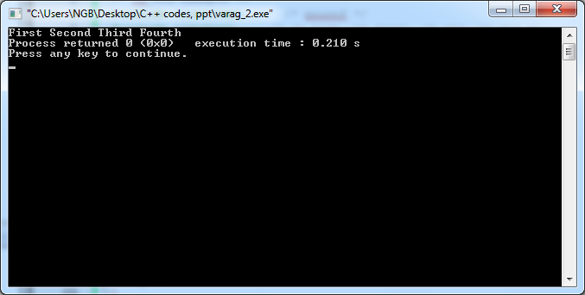
Output

Slide 42
Program 4
#include <iostream> /* printf */
#include <cstdarg> /* va_list, va_start, va_arg, va_end */
using namespace std;
void PrintFloats (int n, ...)
{
int i;
double val;
cout<< "Printing floats:";
va_list vl;
va_start(vl,n);
for (i=0;i<n;i++)
{
val=va_arg(vl,double);
cout<<val<< " ";
}
va_end(vl);
cout<<endl;
}

Slide 43
Program 4
int main ()
{
PrintFloats (3,3.14159,2.71828,1.41421);
return 0;
}

Slide 44
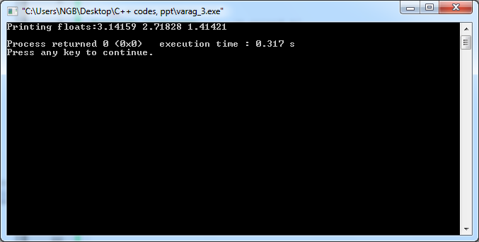
Output

